Slide 1
Operating Systems
Chapter 7(c)
Deadlocks
Hammad Afzal
hammad.afzal@mcs.edu.pk
Department of Computer Software Engineering
National University of Sciences and Technology

Slide 2
Chapter 7: Deadlocks
Deadlock Detection
Recovery from Deadlock

Slide 3
Deadlock Detection
Allow system to enter deadlock state
Detection algorithm
Recovery scheme

Slide 4
Deadlock Detection
Deadlock prevention strategies are very conservative;
limit access to resources and impose restrictions on processes.
Deadlock detection strategies do the opposite
Resource requests are granted whenever possible.
Regularly check for deadlock
Notes:
Deadlock checks can be made as frequently as each resource request or, less frequently, depending on how likely it is for a deadlock to occur.
Checking at each resource request has two advantages:
it leads to early detection,
the algorithm is relatively simple because it is based on incremental changes to the state of the system.
On the other hand, such frequent checks consume considerable processor time.

Slide 5
Single Instance of Each Resource Type
Wait-for Graph
Variant of Resource Allocation Graph
Removing the resource nodes and collapsing appropriate edges.
Maintain wait-for graph
Nodes are processes
Pi → Pj if Pi is waiting for Pj
Pi → Pj will occur only if Pi → R and R → Pi occur in resource allocation graph
Periodically invoke an algorithm that searches for a cycle in the graph. If there is a cycle, there exists a deadlock
An algorithm to detect a cycle in a graph requires an order of n² operations, where n is the number of vertices in the graph

Slide 6
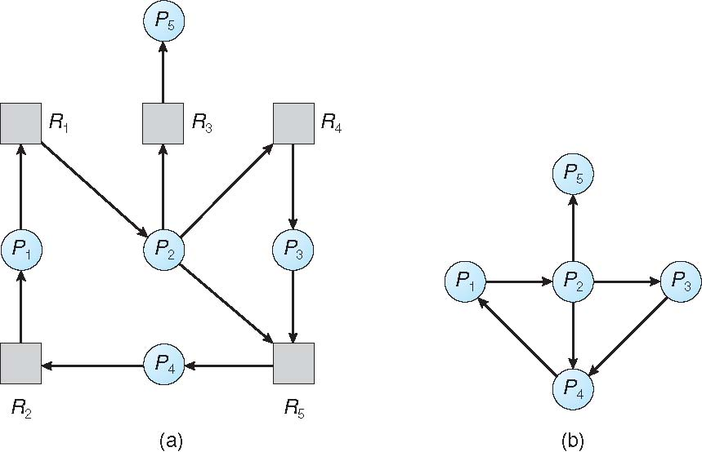
Resource-Allocation Graph and Wait-for Graph
Resource-Allocation Graph
Corresponding wait-for graph

Slide 7
A Common Detection Algorithm
Use a Allocation matrix and Available vector as previous
Also use a request matrix Q
Where Qij indicates that an amount of resource j is requested by process i
First ‘un-mark’ all processes that are not deadlocked
Initially that is all processes
The strategy in this algorithm is to find a process whose resource requests can be satisfied with the available resources, and then assume that those resources are granted and that the process runs to completion and releases all of its resources.
Notes:
A common algorithm for deadlock detection is one described in [COFF71].
The Allocation matrix and Available vector described in the previous section are used.
In addition, a request matrix Q is defined such that Qij represents the amount of resources of type j requested by process i.
The algorithm proceeds by marking processes that are not deadlocked. Initially, all processes are unmarked.

Slide 8
Detection Algorithm
1. Mark each process that has a row in the Allocation matrix of all zeros.
2. Initialize a temporary vector W to equal the Available vector.
3. Find an index i such that process i is currently unmarked and the ith row of Q is less than or equal to W.
i.e. Qik ≤ Wk for 1 ≤ k ≤ m.
If no such row is found, terminate
The strategy in this algorithm is to find a process whose resource requests can be satisfied with the available resources, and then assume that those resources are granted and that the process runs to completion and releases all of its resources.

Slide 9
Detection Algorithm cont.
4. If such a row is found,
mark process i and add the corresponding row of the allocation matrix to W.
i.e. set Wk = Wk + Aik, for 1 ≤ k ≤ m
Return to step 3.
A deadlock exists if and only if there are unmarked processes at the end
Each unmarked process is deadlocked.
The strategy in this algorithm is to find a process whose resource requests can be satisfied with the available resources, and then assume that those resources are granted and that the process runs to completion and releases all of its resources.
Notes:
The strategy in this algorithm is to find a process whose resource requests can be satisfied with the available resources,
and then assume that those resources are granted and that the process runs to completion and releases all of its resources.
The algorithm then looks for another process to satisfy.
Note that this algorithm does not guarantee to prevent deadlock;
That will depend on the order in which future requests are granted.
All that it does is determine if deadlock currently exists.

Slide 10
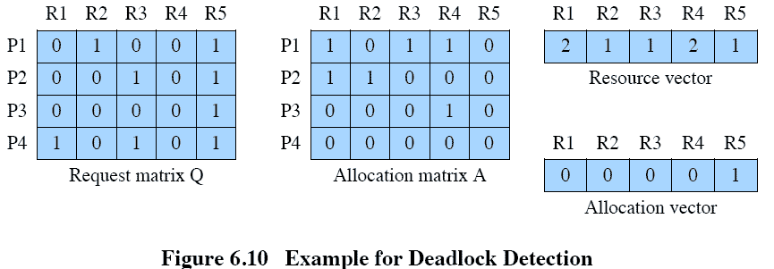
Deadlock Detection
The strategy in this algorithm is to find a process whose resource requests can be satisfied with the available resources, and then assume that those resources are granted and that the process runs to completion and releases all of its resources.
Notes:
1. Mark P4, because P4 has no allocated resources.
2. Set W = (0 0 0 0 1).
3. The request of process P3 is less than or equal to W, so mark P3 and set W=W + (0 0 0 1 0) = (0 0 0 1 1).
4. No other unmarked process has a row in Q that is less than or equal to W.
Therefore, terminate the algorithm.
The algorithm concludes with P1 and P2 unmarked, indicating that these processes are deadlocked.

Slide 11
Recovery from Deadlock
Inform operator to deal with deadlock manually.
Let the system recover from deadlock automatically.
Two options
To abort one or more processes to break the circular wait.
To preempt some resources from one or more deadlocked processes.

Slide 12
Recovery from Deadlock: Process Termination
Abort all deadlocked processes
Great expense.
Processes may be running for a long time and have done lots of computations
Abort one process at a time until the deadlock cycle is eliminated
Overhead: After each process is aborted, deadlock detection algorithm is run.

Slide 13
Recovery from Deadlock: Process Termination
Aborting process is not easy: E.g. if a process was in midst of updating a file, aborting process will leave the file in uncertain state
In case of partial termination, which processes are to be terminated?
Policy decision, similar to CPU-scheduling.
Following characteristics must be considered.
Priority of the process
How long process has computed, and how much longer to completion
Resources the process has used
Resources process needs to complete
How many processes will need to be terminated
Is process interactive or batch?

Slide 14
Recovery from Deadlock: Resource Preemption
Preempt resources from processes and give them to other processes until deadlock is broken.
Three issues need to be addressed
Selecting a victim –
minimize cost (similar as in case of process termination)
Rollback –
return to some safe state, restart process for that state.
Mostly, the safe state is initial state, i.e. restart the process
Starvation –
same process may always be picked as victim, include number of rollback in cost factor

Slide 15
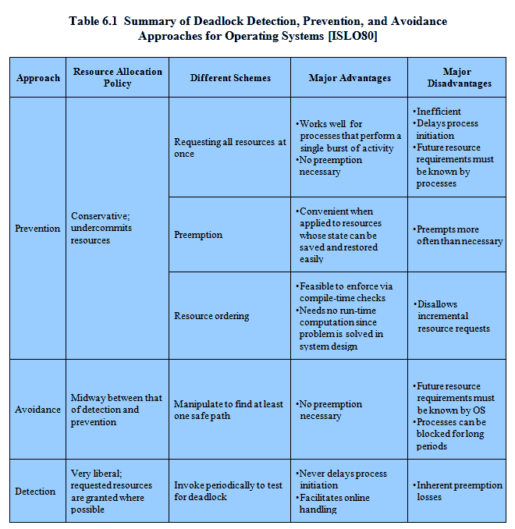
Advantages and Disadvantages
Notes:
There are strengths and weaknesses to all of the strategies for dealing with deadlock.
Rather than attempting to design an OS facility that employs only one of these strategies, it might be more efficient to use different strategies in different situations.

